Slide 1


Slide 2

Day 6: Agenda
Introduction to Clustering
K-Means Clustering
K-Means Algorithm
Choosing the Number of Clusters (K)
Introduction to Hierarchical Clustering
Agglomerative Hierarchical Clustering
Hands-On Practical Example: Customer Segmentation

Slide 3
Unsupervised learning-
Unsupervised learning is the different type of machine learning algorithm specially used when the target variable is absent in dataset, or the dataset is not labelled. The primary goal of unsupervised learning is finding hidden pattern exist within the data.
This can be achieved through grouping the data points into homogenous groups also known as clusters.
Unsupervised learning is much harder and complex than supervised learning as the results are hard to define in the absence of target variable or labels.
The other issue with unsupervised learning is the definition of objective function. Despite these issues unsupervised (clustering) is used to gain the insight of data before applying a classification model

Slide 4
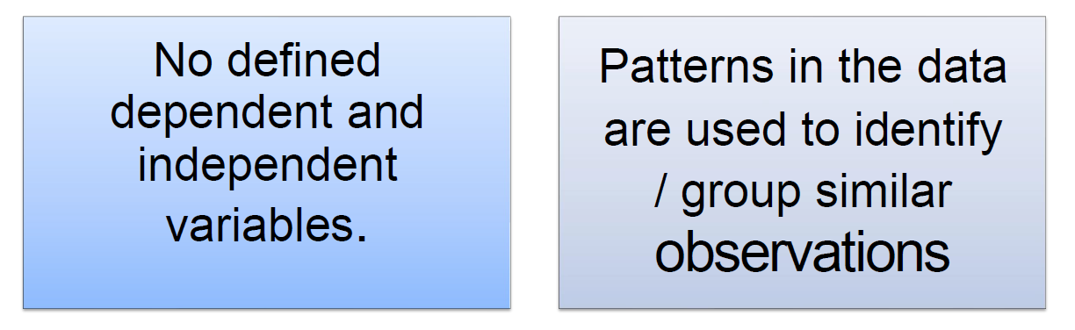
Unsupervised learning-

Slide 5
Unsupervised learning-
Clearly defined X and Y variables
Predict a continuous response (Regression)
Categorical response (classification)
Unlabeled data
Emerging patterns based on similarity identified
Clustering
Association rules (market basket analysis)

Slide 6
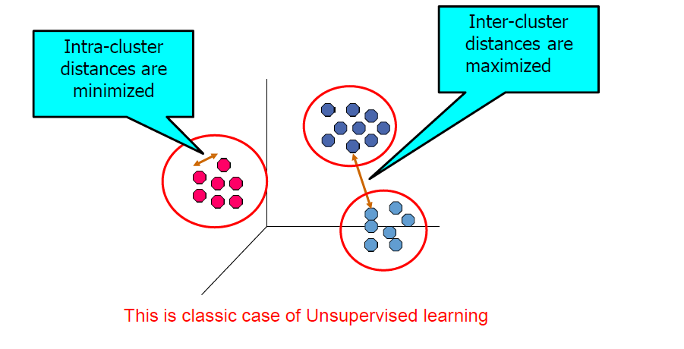
Clustering
Grouping objects
Homogeneity within groups
Heterogeneity between groups
SSB > SSW
Clustering results are used:
As a stand-alone tool to get insight into data distribution
Visualization of clusters may unveil important information
As a preprocessing step for other algorithms
Group records such that
Similar to one another within the same cluster
Dissimilar to the objects in other clusters

Slide 7
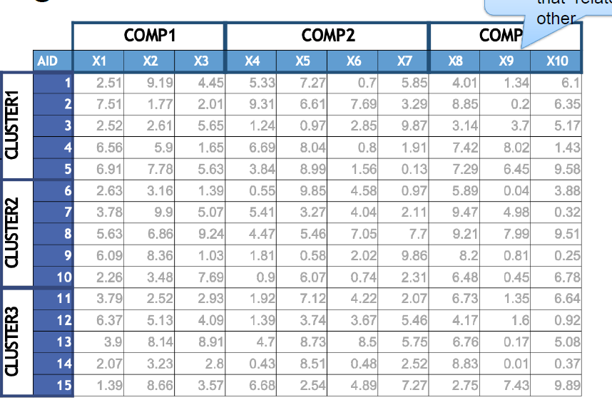
PCA –grouping variables that relate to each other
Clustering –Segment variables according to the distance between them.
Clustering

Slide 8
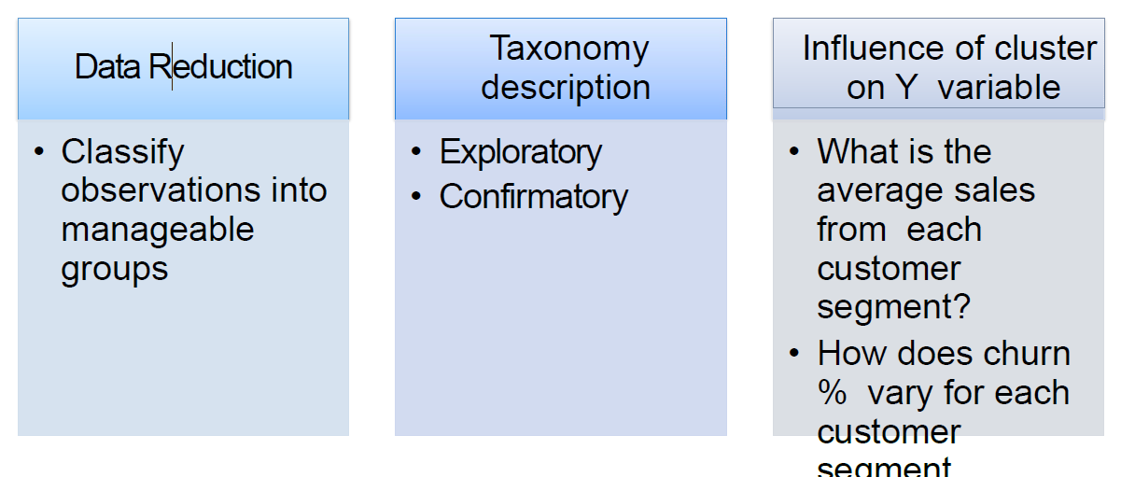
Role of cluster analysis

Slide 9
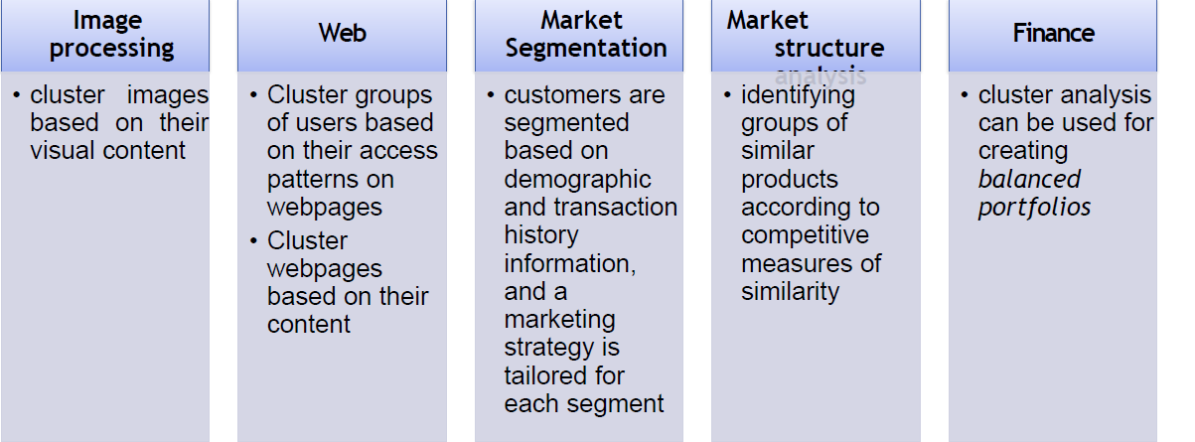
Use cases

Slide 10
Clustering
Clustering is one of fundamental problem of unsupervised learning algorithm defined as the process of dividing the simple data points into homogeneous groups of similar data points. Grouping of data points is based on the similarities and dissimilarities between them, the points within same group are similar and among different groups they are dissimilar. This could be understood by following figure where similar data points are clustered based on color.

Slide 11
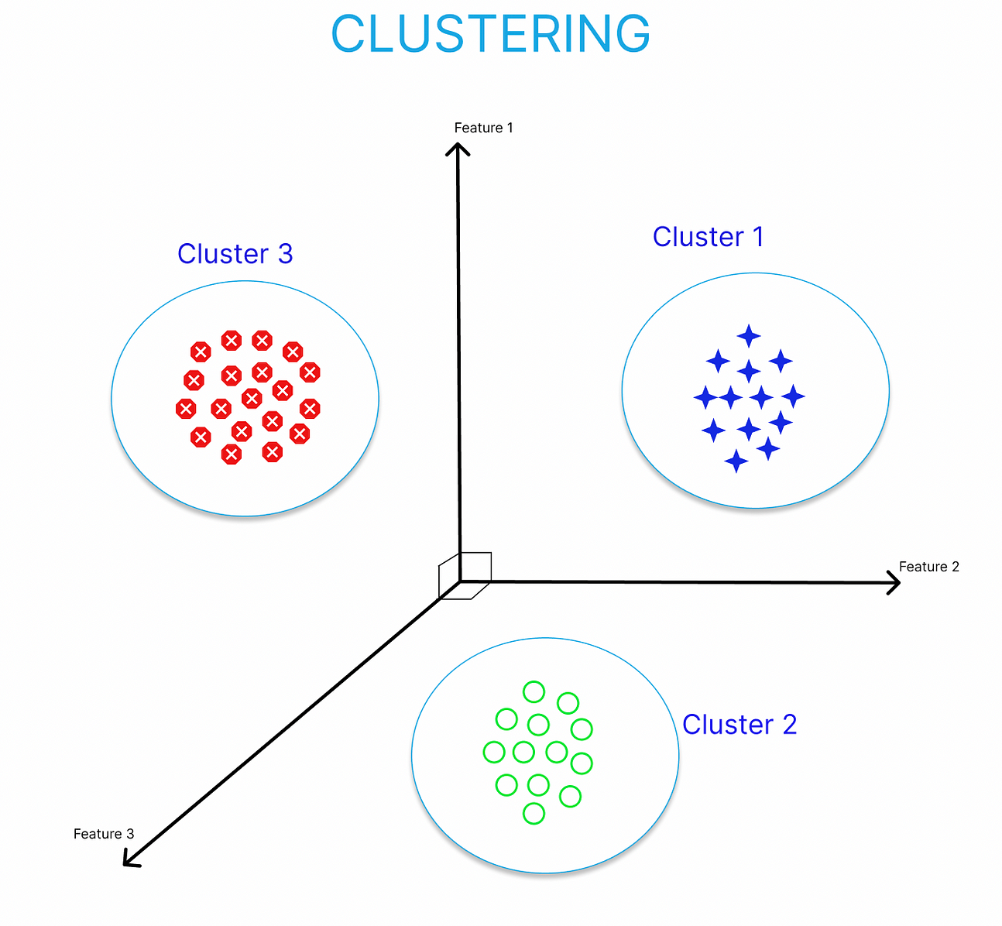
What is Clustering?
Definition: Clustering is the process of grouping similar data points together based on their features.
Applications: Clustering is used for customer segmentation, image analysis, anomaly detection, and more.
Importance: It reveals hidden patterns, simplifies complex data, aids decision-making, and enhances data visualization.

Slide 12
Types of clustering
Primarily clustering is classified as Partitional clustering and Hierarchical clustering.
In this note we will describe partitional clustering. Partitional clustering is the type of clustering in which the data points within the dataset are classified into different groups based on their similarities. Ex: K-means Clustering, CLARA etc.

Slide 13
Types of Clustering
Partitioning Clustering:
  In partitioning clustering, data points are divided into non-overlapping clusters.
  Common algorithms include K-Means and PAM (Partitioning Around Medoids).
  It is efficient and scales well to large datasets.
Hierarchical Clustering:
  Hierarchical clustering builds a hierarchy of clusters, represented as a tree-like structure or dendrogram.
  Agglomerative and divisive methods are commonly used.
  Useful for exploring data at different granularity levels.

Slide 14
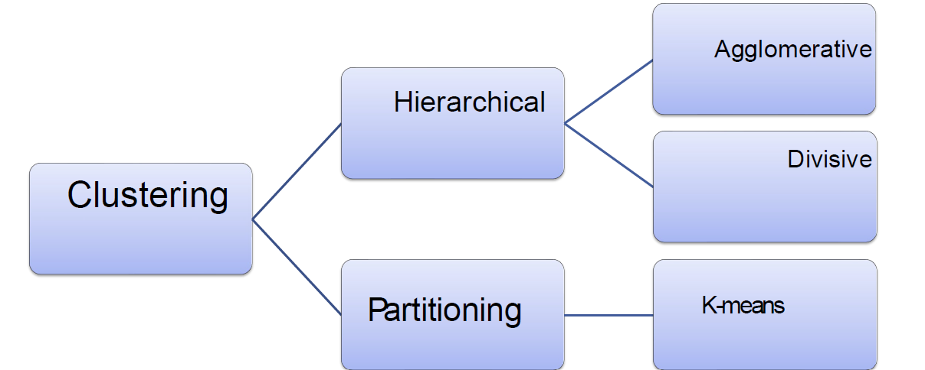
Types of clustering

Slide 15
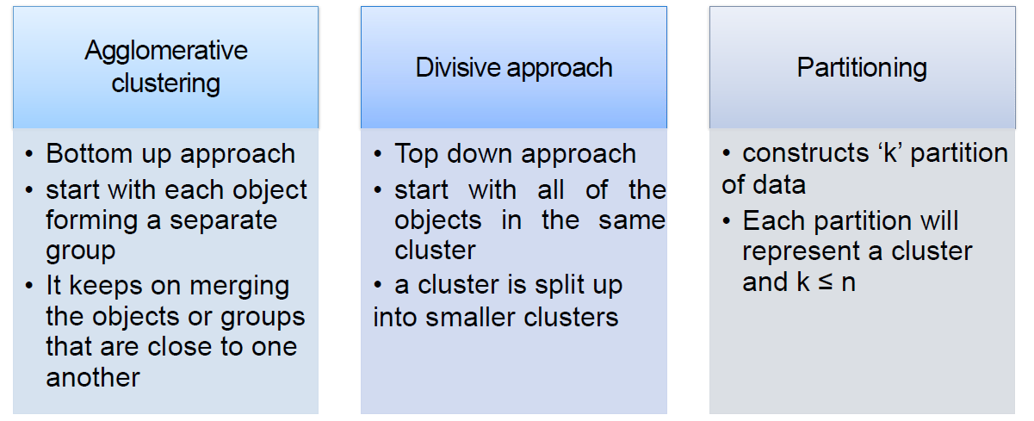
Types of clustering

Slide 16
Hierarchical clustering
Records are sequentially grouped to create clusters, based on distances between records and distances between clusters.
Hierarchical clustering also produces a useful graphical display of the clustering process and results, called a dendrogram.
Strengths of Hierarchical Clustering
No assumptions on the number of clusters
Any desired number of clusters can be obtained by ‘cutting’
the dendrogram at the proper level
Hierarchical clustering may correspond to meaningful taxonomies
Disadvantages of Hierarchical clustering
Time complexity: not suitable for larger datasets.
Very sensitive to outliers

Slide 17
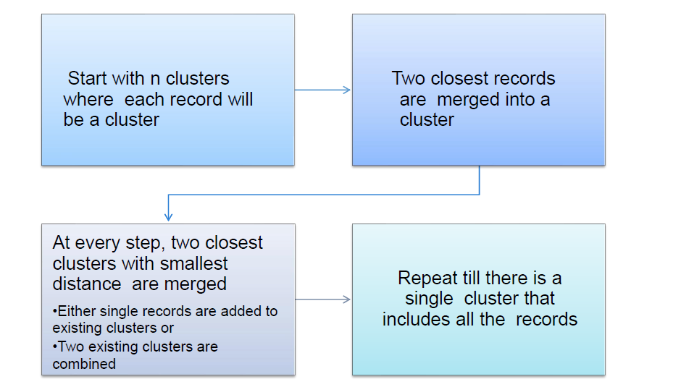
Hierarchical clustering -Steps

Slide 18
K-Means Clustering
K-Means clustering is a partitioning clustering technique that groups data into K distinct, non-overlapping clusters. It aims to minimize the distance between data points within the same cluster and maximize the distance between different clusters.
Use Cases and Examples:
  Customer Segmentation: Retailers use K-Means to group customers based on purchasing behavior.
  Image Compression: K-Means reduces the number of colors in an image to compress it.
  Anomaly Detection: It helps identify unusual patterns in data, such as fraudulent transactions in finance.
K-Means is a widely used and efficient clustering method with applications in various fields.

Slide 19
K-Means Clustering
K-means clustering is a unsupervised learning algorithm whose goal is to find groups or assign the data points to clusters based on their similarity. Which means the points in same cluster are like each other and in different clusters are dissimilar with each other. It was developed by researcher named James Macqueen in 1967. Here K means the number of clusters.
The above figure is showing the working of K-means clustering. Left part is showing the data points before applying the K-means whereas the right part is depicting the situation after the clustering. (data points are grouped into clusters. K-means clustering is very useful and beneficial when most of the data is in unorganized manner. Before moving forward let define some terminology
Cluster- It is a collection of the given data points accumulated together because of certain similarities between them

Slide 20
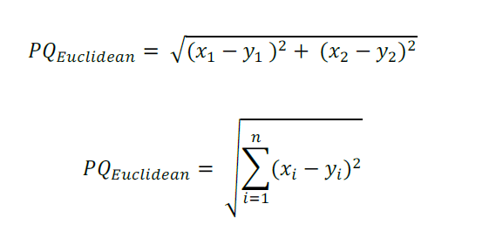
K-Means Clustering
Centroid- It can be termed as a real or imaginary location which represents the centre of the cluster.
Parameter K- K is a target variable which refers to the number of centroids in the respective or given dataset. It is used to label the new data.
Means- In K-means clustering, ‘means refer to the averaging of data used to find the centroid in a the cluster.
The working of K-means clustering is depending on the distance metrics, which are used to find the similarity within data points. The popular distance metric are:
Euclidean Distance-
It is the most commonly used distance metrics and defined as the square root of the sum of squared differences between the two points. Let the two points are P(x1, x2) and Q (y1, y2) the Euclidean distance
is given by:

Slide 21
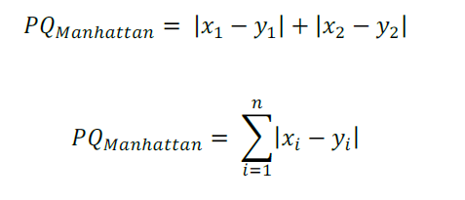
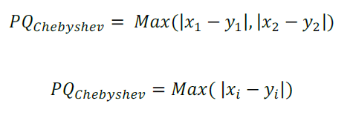
K-Means Clustering
Manhattan Distance-It is also known as city block distance or absolute distance. The distance measure is inspired with the structure of Manhattan city where the distance between two points is measured through city road grids. The distance is defined as the sum of absolute differences between two points coordinates.
Chebyshev Distance-
This distance is also known as Maximum value distance or chessboard distance. The distance is based on absolute magnitude between the coordinates of pair of two points. This distance is equally used with the quantitative and ordinal variable.

Slide 22

K-Means Clustering
Minkowski Distance- Minkowski distance is one of the generalized distance measures, which means that by manipulating the formula different distances measures can be obtained. Above stated distance measures are the special case of Minkowski distance.
When p =1 Minkowski has become Manhattan distance.
When p =2 Minkowski has become Euclidean distance.
When p = ∞ Minkowski has become Chebyshev distance.

Slide 23

K-Means Clustering
Mahalanobis Distance-
This distance measure is used to calculate the distance between two points in multivariate space.
The idea is to calculate the distance of a point P from any distribution D in terms of standard deviation
and mean of distribution D. The main advantage of mahalanobis distance is that it includes the covariance
of distribution to measure the similarity between two points. The distance equation is given by:
Where P and Q are two random vectors of same distribution and S is covariance matrix.
NOTE: Most widely used distance measure is Euclidean distance, But all the distances have their
respective purpose and importance. One cannot say or claim that only one distance measure
is always accurate.

Slide 24
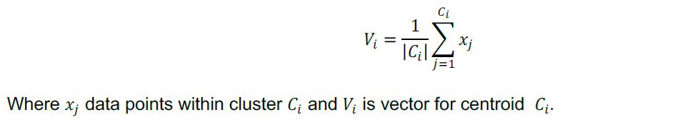
K-Means Clustering
Working of K-means Clustering- The working of k-means clustering can be summarized as:
Step 1- Initialize the K random centroids or k points.(There can be two strategy for it.)
i. Pick random data points and consider those as starting points.
ii. Choose K random values for each particular variable.
Step 2- For each data point calculate the distance of it from randomly chosen K centroid 𝐶' and assign
each point to minimum distance cluster.
Step 3- Update the centroid by using newly assigned data points to the cluster by calculating the
average of data points.
Step 4- Repeat the above process for a given no. of iterations or until the centroid allocation no longer
changes.
The algorithm is said to be converged once there are no more changes in the values of centroids.
Following figure is showing the above stated process of k-means clustering.

Slide 25
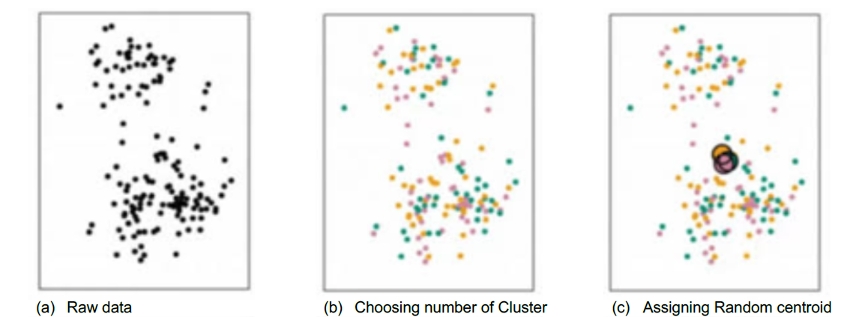
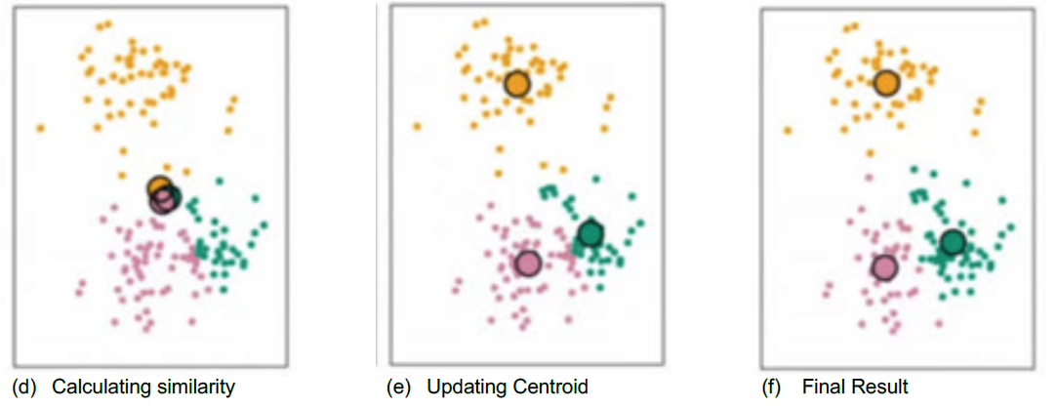
K-Means Clustering

Slide 26

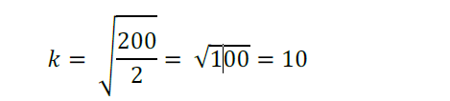
K-Means Clustering
Objective of clustering-
The objective of clustering is to minimize the distance between data points and its centroid, which can
also be expressed as square error term defined as:
Choosing No. of Clusters( value of k)-
Basically, there is no such method for define the exact value of k, but there is quick rule of thumb
which can be used as heuristic to get the maximum number of clusters as
where N= no. of data points. For example, take N=200 data points, then no. of clusters will be:
Hence 10 clusters will be formed for 200 data points.
There are some other techniques from which can be used to find the approximate or optimal value of k.
These techniques includes:
1. Elbow Method
2. Silhouette method
3. The information theoretic jump, the information criteria.
This note will discuss the Elbow method (which is most popular) and Silhouette method to determine the
optimal value of number of clusters

Slide 27
Methods of K Selection
Elbow Method:
The Elbow Method helps choose the optimal number of clusters (K) in K-Means.
Usage: It involves running K-Means with different K values and plotting the sum of squared distances (inertia) for each K. The "elbow" point on the graph, where inertia starts to level off, is often the optimal K.
Silhouette Score:
Silhouette Score evaluates the quality of clusters.
Usage: It measures how similar data points are to their own cluster (cohesion) compared to other clusters (separation). A higher Silhouette Score indicates better clustering. It's calculated for various K values, and the K with the highest score is selected as optimal.

Slide 28
Elbow method-
It is most popular and well-known method to find the optimal no. of clusters or the value of k in
the process of clustering. This method is based of plotting the value of cost function against different
values of k. As the number of clusters (k) increase lesser number of points fall within clusters or around the centroids. Hence the average distortion decreases with the increase of number of clusters. The point where the distortion declines most is said to be the elbow point and define the optimal number of clusters for dataset.
As it is clear from above figure, the distortion declines most at 3. Hence the optimal value of k will be 3 for performing the clustering. In other words the plot looks as an arm with an elbow at k = 3.

Slide 29
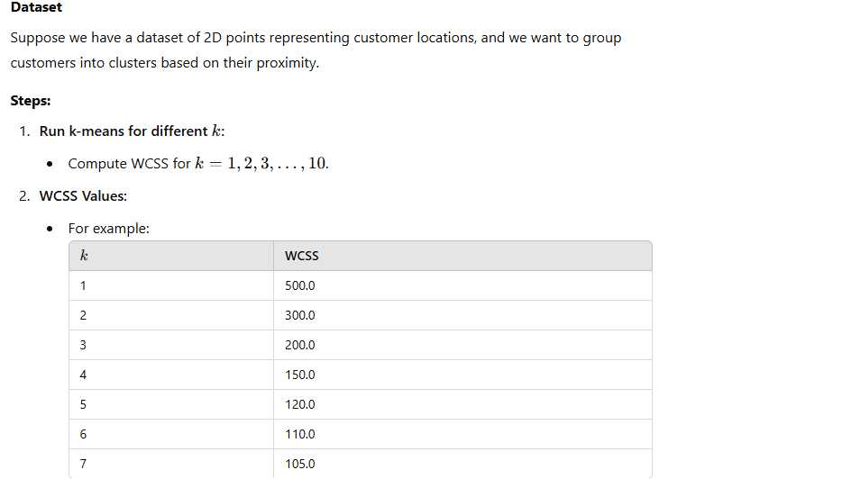
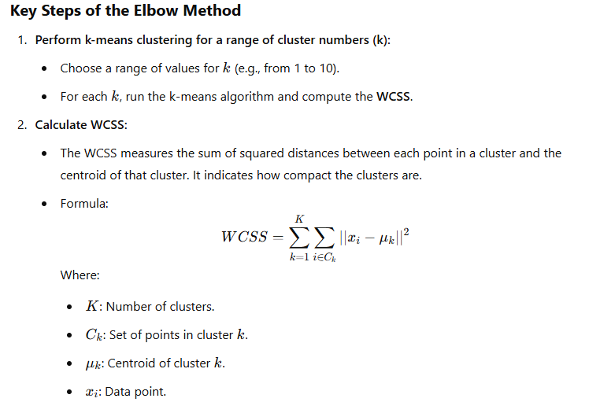
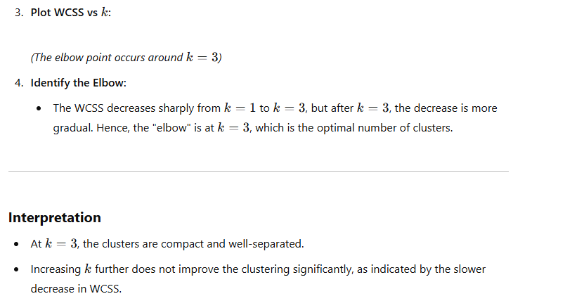
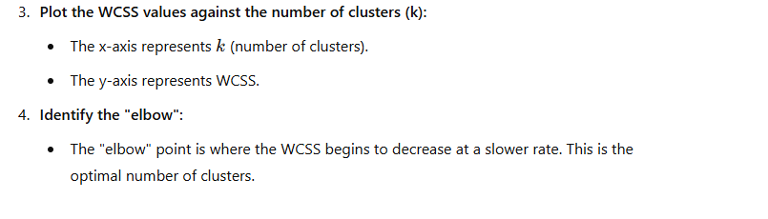
Elbow method-

Slide 30
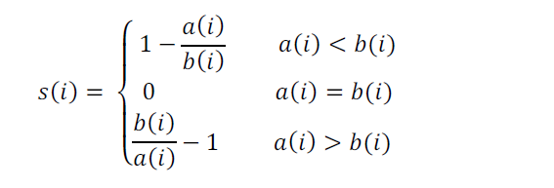
Silhouette Method-
Silhouette is a different method to determine optimal number of clusters for given dataset. It defines as a coefficient of measure of how similar an observation to its own cluster compared to that of other clusters. The range of silhouette coefficient varies between -1 to 1. 1 value indicate that an observation is far from its neighbouring cluster and close to its own whereas -1 denotes that an observation is close to neighbouring cluster than its own cluster. The 0 value indicate the presence of observation on
boundary of two clusters. Silhouette coefficient is defined as:
Where 𝑎(𝑖) is the distance of observation within its own cluster and 𝑏(𝑖) is the distance of observation
with its neighbouring cluster.

Slide 31
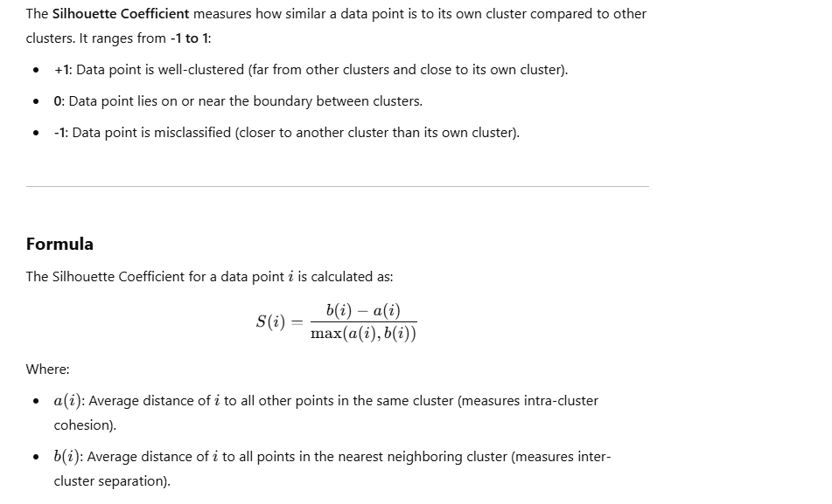
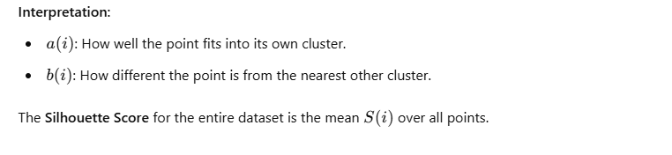
Silhouette Method-

Slide 32
K Means
Advantages of K-means clustering:
- Ease of implementation.
- It works great on large scale data.
- Results guarantees convergence.
- Easily works with new examples.
Disadvantages of K-means clustering:
- It is quite difficult to predict number of clusters.
- Initialization of the cluster center is a really crucial part and also somewhat tough.
- K- means clustering only handles numeric data.

Slide 33
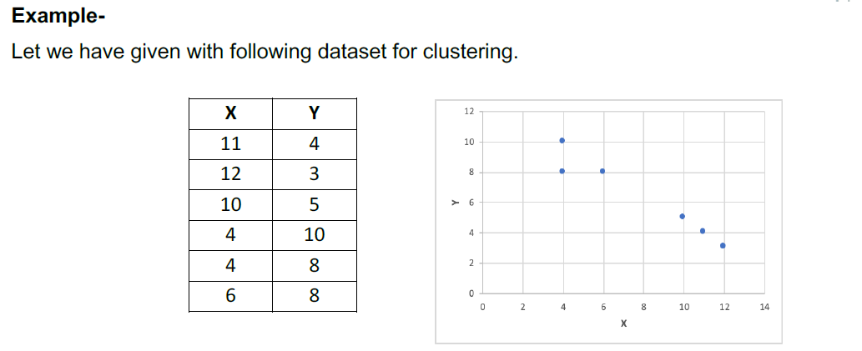
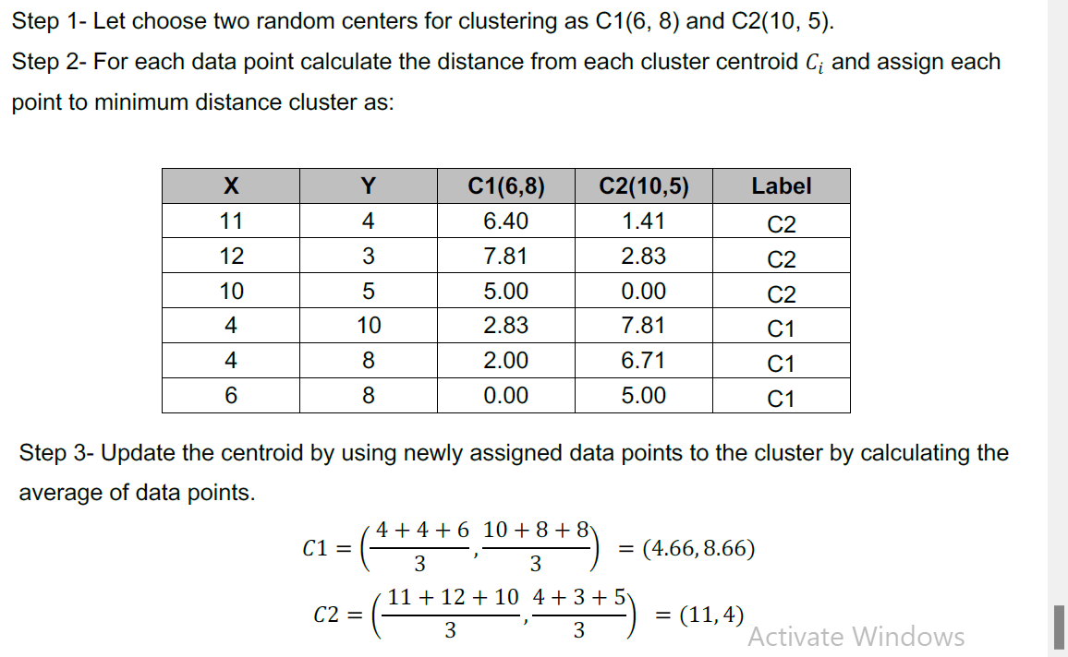
ExAMPLE

Slide 34
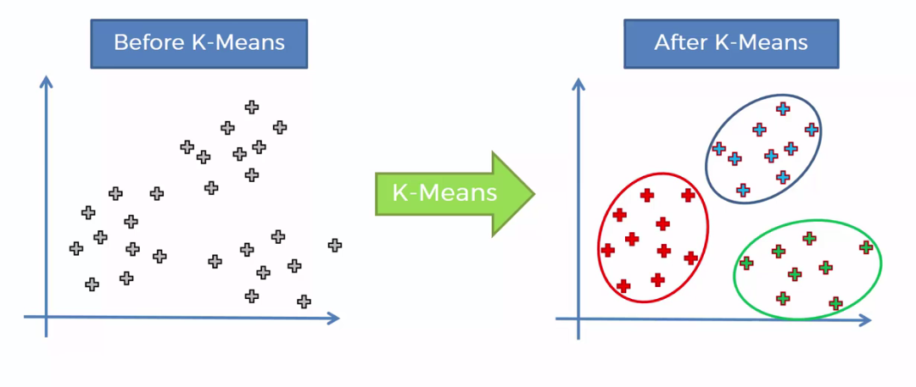
K-Means Clustering

Slide 35
K-Means Algorithm
Initialization: Start with K initial cluster centroids.​
Assignment Phase: Assign each data point to the nearest centroid based on distance.​
Update Phase: Recalculate centroids as the mean of data points in each cluster.​
Iteration: Repeated assignment and update phases until convergence.​
Result: Final cluster assignments represent the solution.

Slide 36
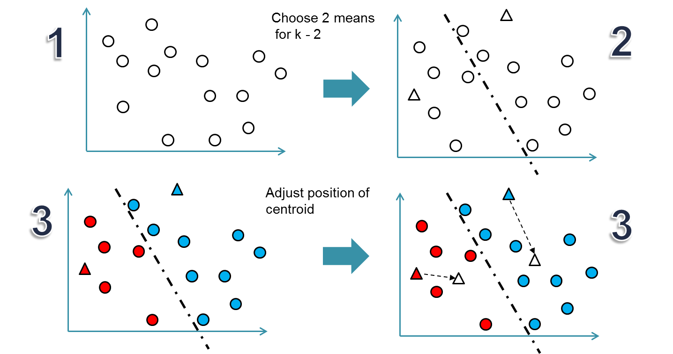
K-Means Algorithm

Slide 37
Question
Using the "customer_segmentation.csv" dataset, find the optimal number of clusters (K) for K-Means clustering. Apply the Elbow Method and Silhouette Score to determine K.
Notes:
Note:- Use Jupyter file for this question - Elbow Method & Silhouette Score for K selection - Customer Segmentation Dataset.ipynb

Slide 38
Hierarchical Clustering
Hierarchical clustering builds a cluster hierarchy, starting with individual data points and progressively merging them based on similarity.
Advantages:
  Provides a visual hierarchy (dendrogram).
  No need to specify the number of clusters in advance.
Use Cases:
  Biology (phylogenetics).
  Document clustering.
  Image segmentation.
  Understanding hierarchical relationships in data.

Slide 39
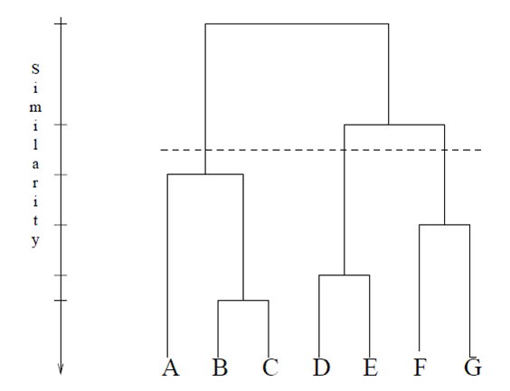
Hierarchical Clustering

Slide 40
Agglomerative Hierarchical Clustering
Agglomerative hierarchical clustering is a "bottom-up" approach. It starts with each data point as an individual cluster and iteratively merges the closest clusters until a single cluster contains all data points.
Hierarchy Building:
  Start with each data point as a separate cluster.
  Identify the two closest clusters and merge them.
  Repeat step 2 until all data points are in a single cluster or a predefined stopping criterion is met.
  The hierarchy is represented as a dendrogram, showing the sequence of merges.
Agglomerative hierarchical clustering progressively combines data points into larger clusters based on their proximity, leading to a hierarchical structure.

Slide 41
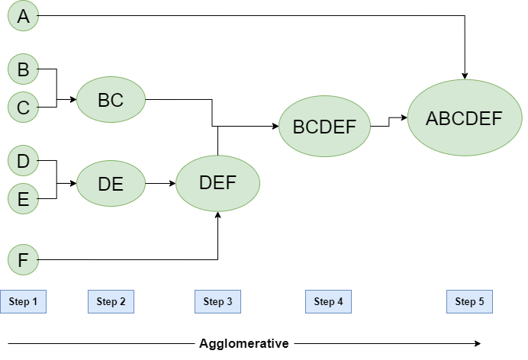
Agglomerative Hierarchical Clustering

Slide 42
Agglomerative Clustering Steps
Initialization: Begin with each data point as an individual cluster.
Pairwise Distance: Calculate pairwise distances (e.g., Euclidean) between all clusters.
Cluster Merge: Merge the two closest clusters based on linkage criteria (e.g., single, complete, or average linkage).
Distance Update: Recalculate distances between the merged cluster and other clusters.
Repeat: Repeat steps 2 to 4 until a single cluster containing all data points is formed or a stopping criterion is met.

Slide 43
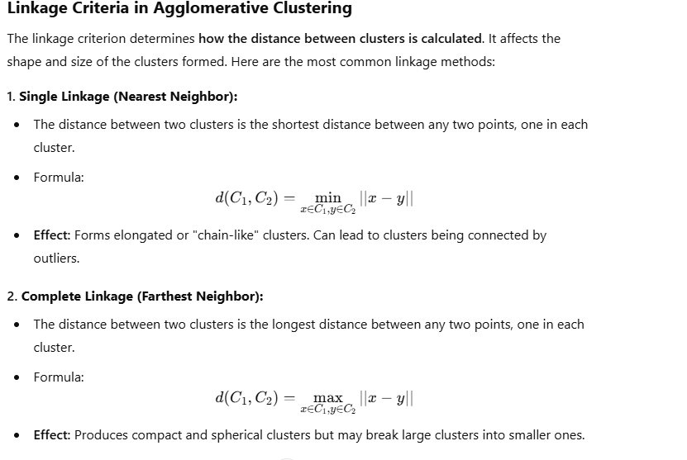
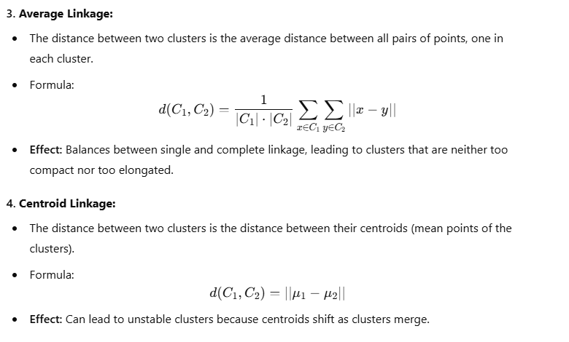

Slide 44
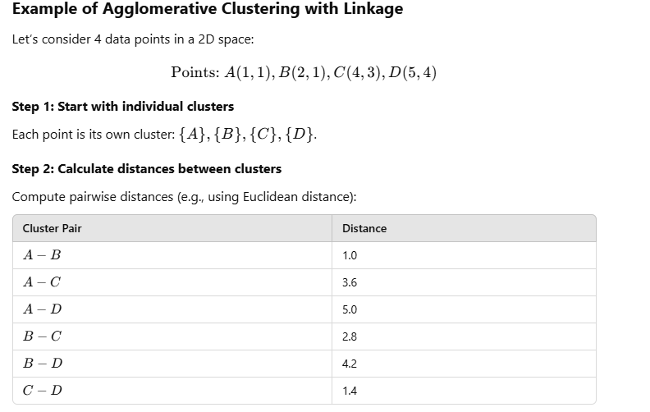
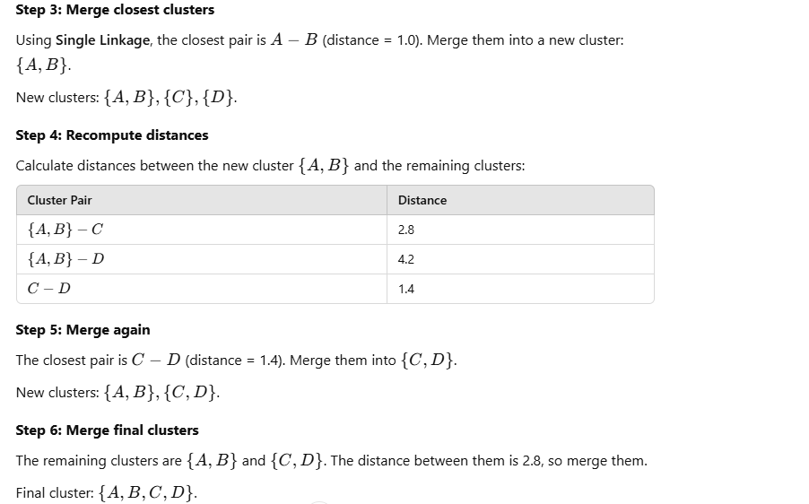

Slide 45
Agglomerative Clustering Steps
Linkage Criteria:
Single Linkage: The distance between two clusters is the minimum distance between any two data points, one from each cluster.
Complete Linkage: The distance between two clusters is the maximum distance between any two data points, one from each cluster.
Average Linkage: The distance between two clusters is the average distance between all data point pairs, one from each cluster.

Slide 46
Distance between two clusters
Each cluster is a set of points
How do we define distance between two sets of points
Single linkage
The distance between two clusters is defined as the shortest distance between any two points, one from each cluster.
Hierarchical clustering –Distance between clusters
Linkage types
Single linkage
Complete linkage
Average linkage
Centroid linkage
Ward’s Method
Complete linkage
The distance between two clusters is defined as the longest distance between any two points, one from each cluster.
Average linkage
Distance between two clusters is defined as the average distance between each point in one cluster to every point in the other cluster.

Slide 47
Dendrogram
A dendrogram is a tree-like diagram in hierarchical clustering, displaying the sequence of cluster merges.
A dendrogram is a treelike diagram that summarizes the process of clustering
On the x-axis are the records
Similar records are joined by lines whose vertical length reflects the distance between the records
the greater the difference in height, the more dissimilarity
By choosing a cutoff distance on the y-axis, a set of clusters is created
Interpretation and Use:
  Visualizes hierarchical cluster structure.
  Helps determine optimal cluster granularity.
  Aids in understanding data point relationships and similarities.

Slide 48
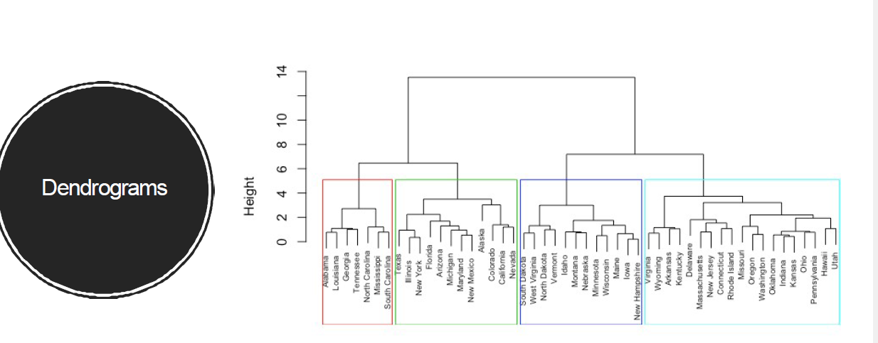
Dendrogram

Slide 49
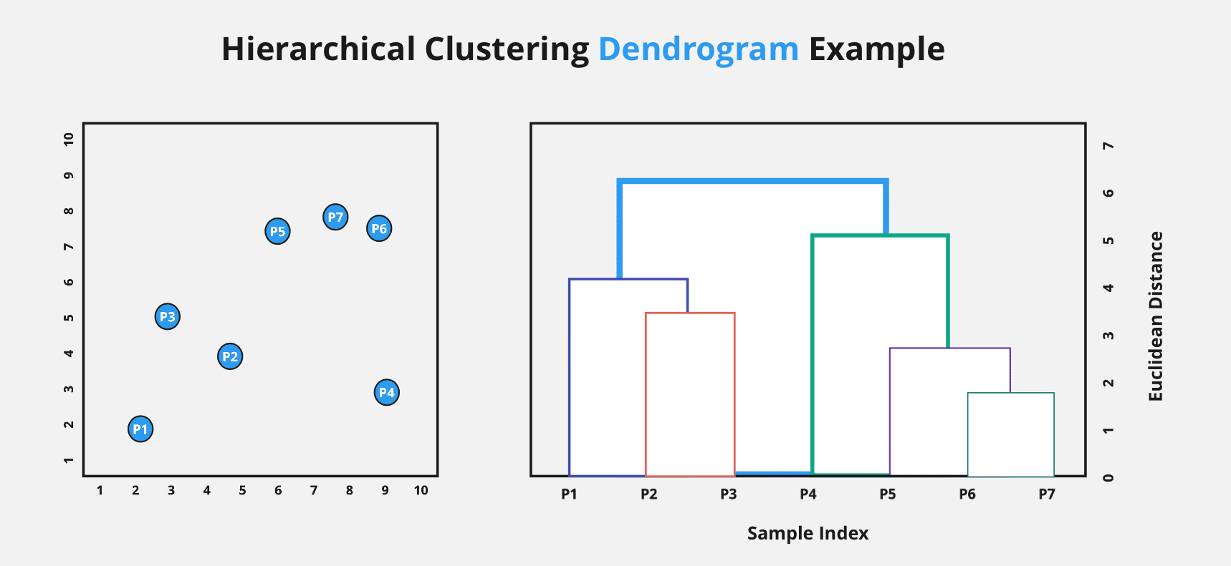
Dendrogram

Slide 50
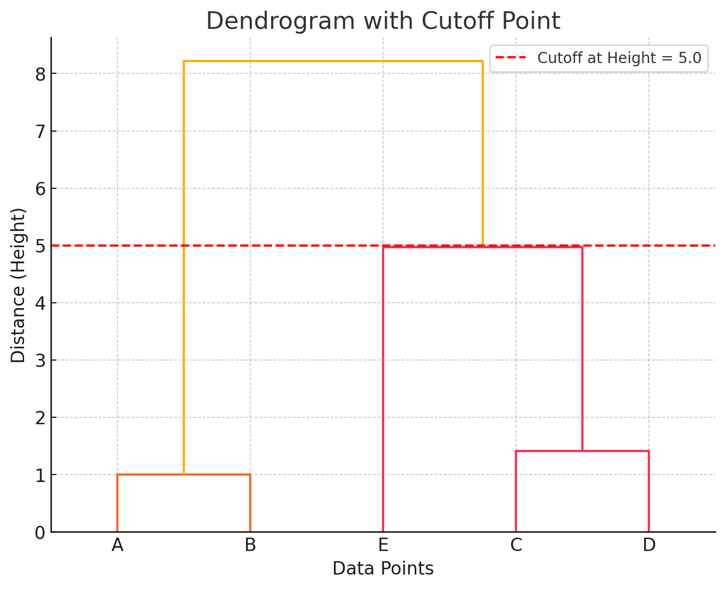
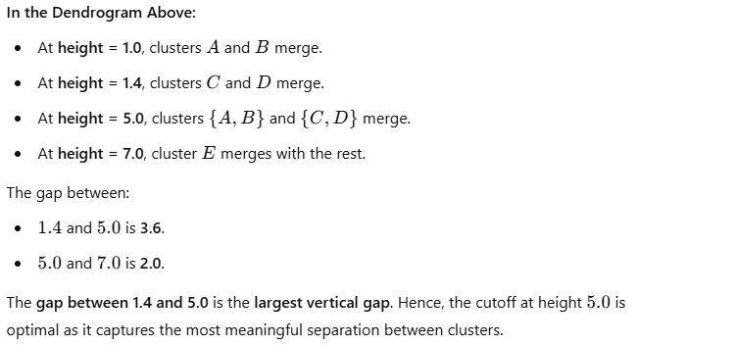
Dendrogram

Slide 51
Scaling
Centroid linkage
Based on centroid distance. clusters are represented by their mean values for each variable, which forms a vector of means.
Distance between 2 clusters is distance between the 2 vectors
ZScaling
Features will be rescaled
Have the properties of a standard normal distribution
μ=0 and σ=1
Ward’s Method
Like group average and centroid distance
joins records and clusters together progressively to produce larger and larger clusters but operates slightly differently from the general approach.
32
Min Max scaling
The data is scaled to a fixed range -0 to 1.
The cost of having this bounded range -smaller standard deviations, which can suppress the effect of outliers

Slide 52
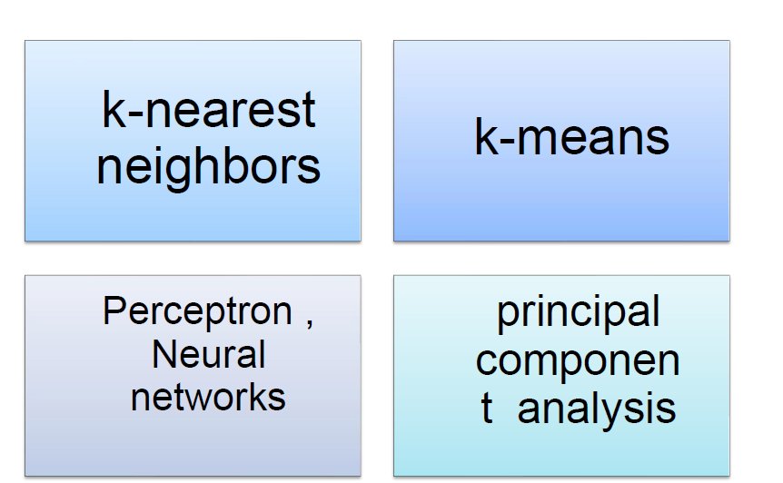
Scaling

Slide 53
Question
Write a Python code to perform K-means clustering on the provided bank transaction dataset, using the Elbow Method to determine the optimal number of clusters
Notes:
Note:- Use Jupyter file for this question - K-Means Clustering - Bank Transaction Dataset.ipynb

Slide 54
Questions ?

Slide 55
Thank You !

